Slide 1


Pitt CSD R Workshop (This is a practice run)
Rob Cavanaugh
Emily Goldberg
Alex Swiderski
Notes:
Thanks for coming to our practice run
We hope you get something out of it
We’re happy that we can practice with youall
Some of the content may be geared towards incoming PhD students rather than seasoned researchers – we know you know some of this stuff, but we’re going to practice it anyway

Slide 2

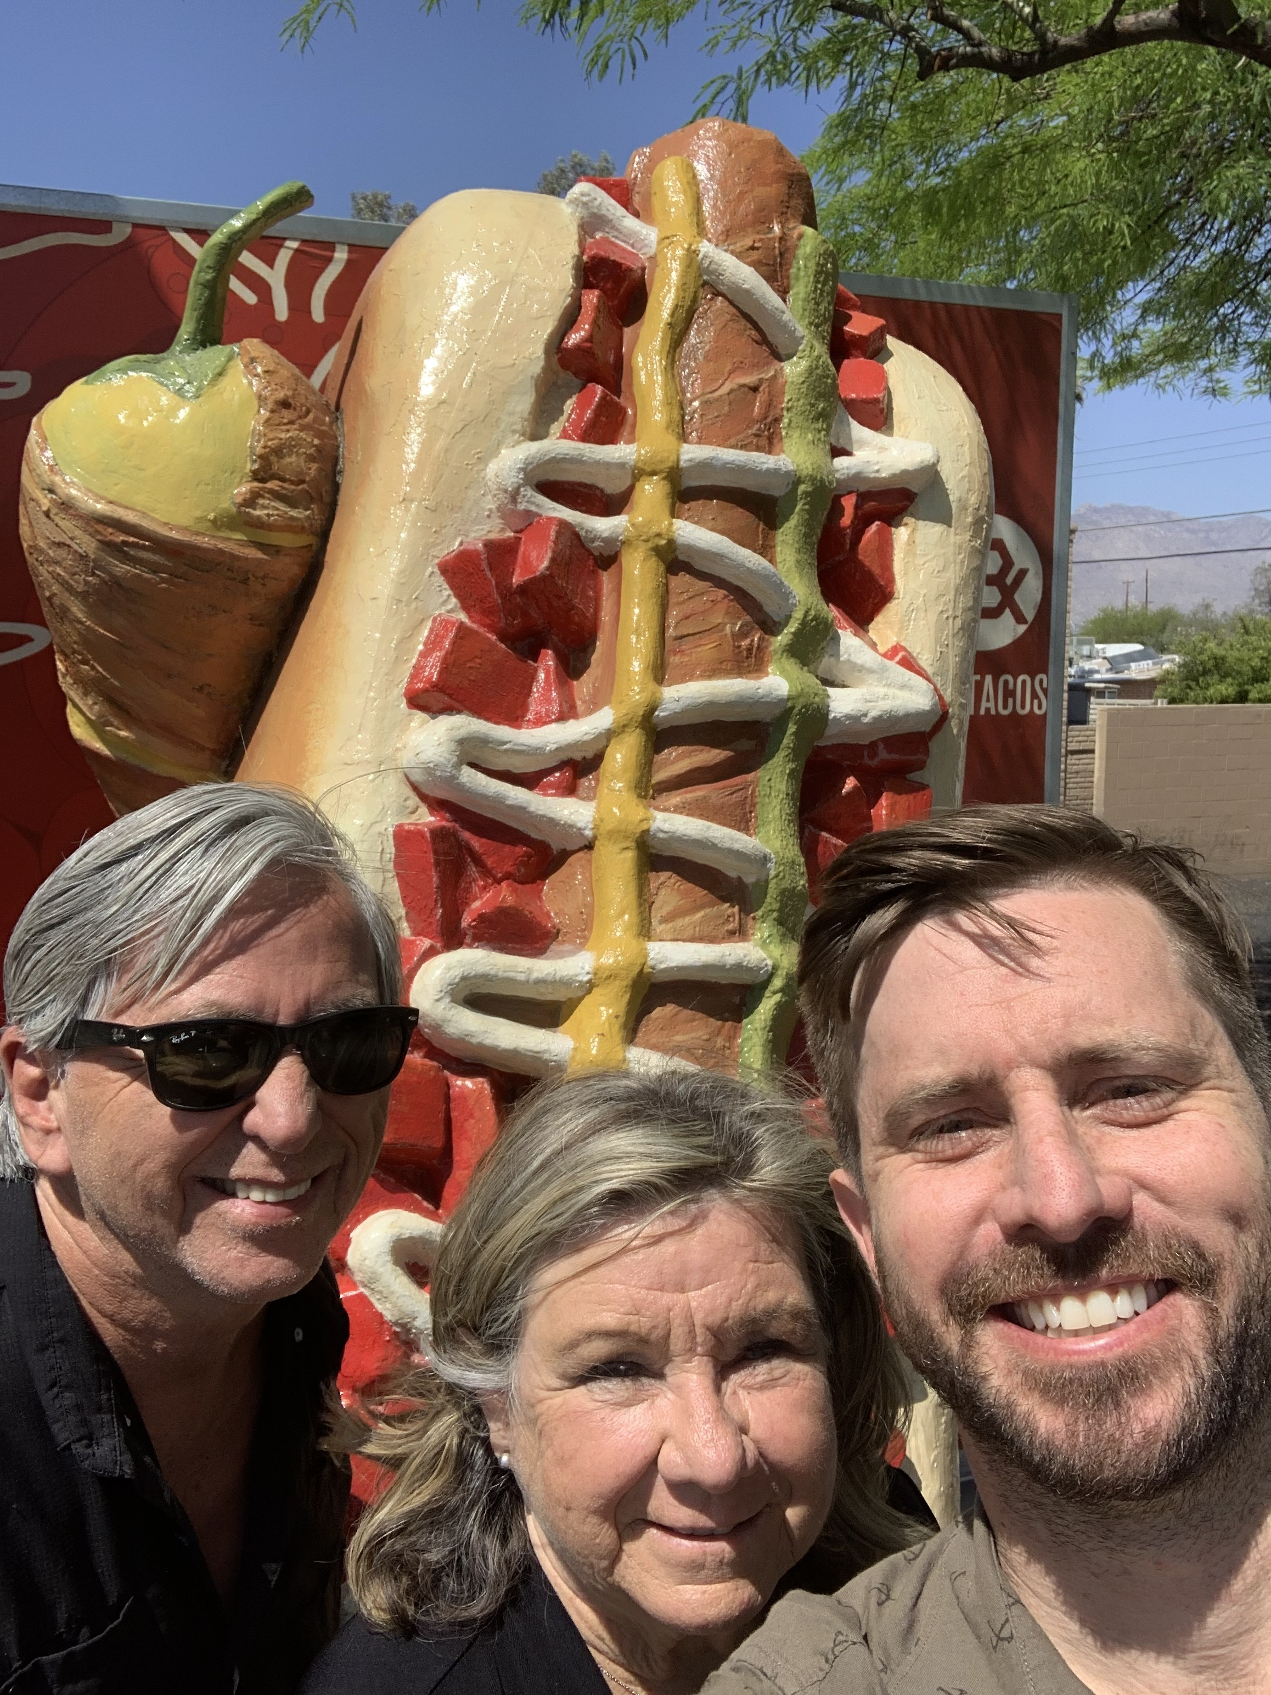
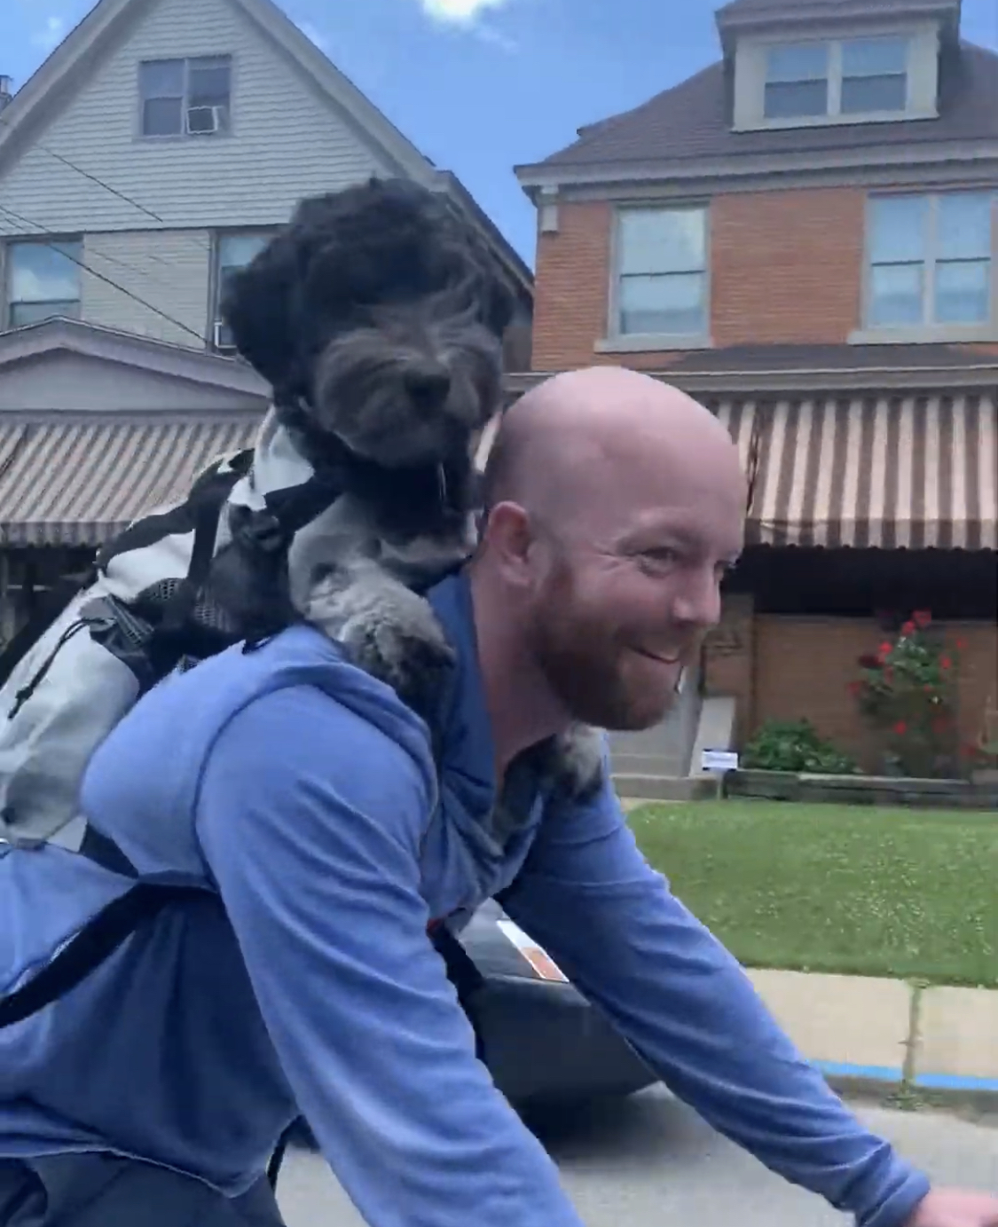
Introduction
Rob
Emily
Alex
Bikes with puppies
Enthusiastically selects reply all
Likes hotdogs with sweet relish

Slide 3
What is R, and why use it?
conducting reproducible research
automating data processing pipelines
creating high-quality visualizations
conducting statistical analyses
R is a free (open source) programming environment for data processing and statistical analysis.
R allows you to write scripts and computational markdown documents that organize, process, analyze, and visualize data.

Slide 4
Workshop format
1. Introduction to R
2. Exploratory data analysis
3. Data wrangling
4. R-markdown
Some didactic information
Hands-on coding together
Activity in break-out rooms

Slide 5

Ask questions anytime
If you’re unsure about something, someone else is too.
Ask questions in the chat
Raise your zoom hand

Slide 6
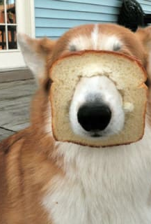
Accept that you will get stuck
Trial and error is a great way to learn
Raise your zoom hand

Slide 7
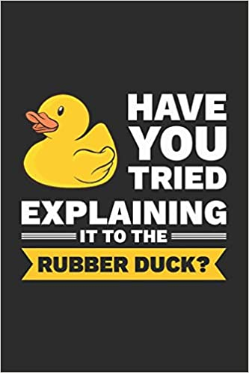
Give and Receive help from peers
Giving help clarifies your own understanding
Other novice R users might be better at explaining things than we are

Slide 8

Be patient with yourself and others

Slide 9
Questions?

